Slide 1


Find The
Treasure!
Play

Slide 2
Welcome to the treasure hunt game
The game consists of a collection of locked boxes, and you must reach the box that contains the pirate's treasure by answering a series of questions about pirates.

Slide 3

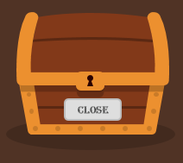
How do you play the game?
1- You must click on the box that says 'Open' to open the question.
2- The box that says 'Closed' on it cannot be opened.

Slide 4


How do you play the game?
3- When the box opens for you, you should click on the number to go to the question.
4- When you answer the question correctly, the button turns green, the word 'Done' is displayed on it, and it closes, allowing you to move on to the next question.

Slide 5
How do you play the game?
If you want to go to the next page, click on the right arrow.
If you want to go back to the previous page, click on the left arrow.

Slide 6

Choose a chest!
open
Close
Close
Close
Close
Close
Close
Close

Slide 7
Chest 1
1
Close
Close
Close
Close
Close
Close
Close

Slide 8
Question 1
What do pirates use to search for treasure?
Map
telescope
phone

Slide 9

Wrong answer
It seems that you are not a true pirate. You have angered the pirate crew, and the cannons will be fired at you now if you do not try to answer again.

Slide 10
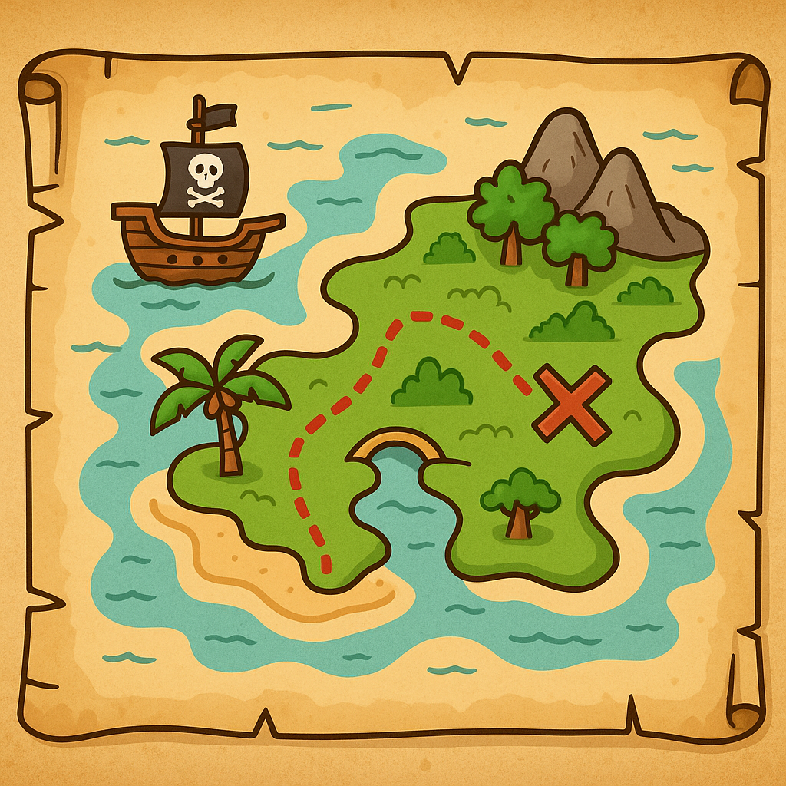
Well done
A pirate map is an ancient map often drawn on yellowed paper or old leather, used by pirates to locate buried treasure. It features strange markings such as mountains, trees, and rivers, and contains a winding or dotted line that leads to a red 'X' mark, which indicates the location of the treasure. Typically, the map is not entirely clear and requires pirates to be clever and adventurous to decipher its codes and reach the hidden treasure in the depths of a remote island.

Slide 11
Choose a chest!
Done
open
Close
Close
Close
Close
Close
Close

Slide 12
Chest 2
2
Done
Close
Close
Close
Close
Close
Close

Slide 13
Question 2
What is the thing that is marked with an 'X' on a pirate map?
ship
Monster
treasure

Slide 14
Wrong answer
It seems that you are not a true pirate. You have angered the pirate crew, and the cannons will be fired at you now if you do not try to answer again.

Slide 15
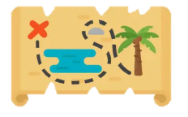
Well done
"X" marks the spot is the most famous symbol found on pirate maps, indicating the location of buried treasure. When pirates see the "X" mark, they know that this is the ultimate destination of their long and perilous journey. The mark is often placed at the end of a dotted path or after passing several signs on the map. The "X" has become a universal symbol of adventure and treasure, generating excitement and thrill in the hearts of children and fans of pirate stories, as it signifies that treasure awaits those who discover it.

Slide 16
Choose a chest!
Done
Done
open
Close
Close
Close
Close
Close

Slide 17
Chest 3
3
Done
Done
Close
Close
Close
Close
Close

Slide 18
Question 3
What is the animal that pirates love and often carry on their shoulder?
Duck
Parrot
Cat

Slide 19
Wrong answer
It seems that you are not a true pirate. You have angered the pirate crew, and the cannons will be fired at you now if you do not try to answer again.

Slide 20
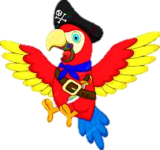
Well done
The parrot is the distinctive and preferred companion of pirates in stories and cartoons. It is often depicted sitting on the pirate's shoulder, repeating words and mimicking sounds in a funny way. The parrot is characterized by its colorful feathers and loud voice, and it was considered an intelligent and entertaining bird that accompanied pirates on their long journeys across the sea. In some stories, the parrot helps the pirate remember places or warns of danger, which is why it has become a fun and beloved symbol in the world of pirate adventures.

Slide 21
Choose a chest!
Done
Done
Done
open
Close
Close
Close
Close

Slide 22
Chest 4
4
Done
Done
Done
Close
Close
Close
Close

Slide 23
Question 4
What is the color of the famous pirate flag?
Red
Black
Blue

Slide 24
Wrong answer
It seems that you are not a true pirate. You have angered the pirate crew, and the cannons will be fired at you now if you do not try to answer again.

Slide 25

Well done
The black flag is a famous symbol in the world of pirates, and it was raised on their ships to declare their identity and instill fear in the hearts of others. This flag is known as the "skull and crossbones flag," as it features a white skull over two crossed bones. Pirates used it to warn other ships that they were coming, and that those who resisted them would face danger. Over time, the black flag has become a distinctive symbol of pirates in stories and movies, and it is widely used today in children’s games and adventures to add an atmosphere of excitement and thrill.

Slide 26
Choose a chest!
Done
Done
Done
Done
open
Close
Close
Close

Slide 27
Chest 5
Done
Done
Done
Done
5
Close
Close
Close

Slide 28
Question 5
What is the name of the ship used by pirates?
boat
Submarine
Pirate Ship

Slide 29
Wrong answer
It seems that you are not a true pirate. You have angered the pirate crew, and the cannons will be fired at you now if you do not try to answer again.

Slide 30
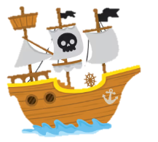
Well done
The ship is the primary means of transport for pirates, serving as their home and the site of their adventures on the high seas. The pirate ship was large and powerful, bearing sails and the black flag, equipped with cannons, ropes, and ladders to board other ships. Pirates lived on board, moving from island to island in search of treasure and adventure. The ship contained sleeping quarters, storage for food, and was often equipped with a map and a lookout to monitor the sea. In pirate stories, the ship represents a symbol of freedom and adventure, and it is the place where every treasure-seeking journey begins.

Slide 31
Choose a chest!
Done
Done
Done
Done
Done
open
Close
Close

Slide 32
Chest 6
Done
Done
Done
Done
6
Done
Close
Close

Slide 33
Question 6
What tool do pirates use to see distant places?
Mirror
Telescope
Microscope

Slide 34
Wrong answer
It seems that you are not a true pirate. You have angered the pirate crew, and the cannons will be fired at you now if you do not try to answer again.

Slide 35

Well done
The telescope is an important tool used by pirates to see distant objects at sea, such as other ships or faraway islands. The pirate would hold the telescope and stand at the highest point of the ship, called the 'crow's nest,' to watch the horizon and search for signs of treasure or approaching danger. The telescope is characterized in pirate stories as being long and foldable, and it is often made of copper and wood. The telescope is considered a symbol of intelligence and observation, and it is an essential part of every maritime adventure undertaken by pirates.

Slide 36
Choose a chest!
Done
Done
Done
Done
Done
Done
open
Close

Slide 37
Chest 7
Done
Done
Done
Done
7
Done
Done
Close

Slide 38
Question 7
Which of these things are not used by pirates?
Sword
Umbrella
flag

Slide 39
Wrong answer
It seems that you are not a true pirate. You have angered the pirate crew, and the cannons will be fired at you now if you do not try to answer again.

Slide 40

Well done
The pirate uses a set of tools that assist him in his sea voyages and adventures in search of treasures. Among the most important of these items are:
• the map, the sword, the compass, the hat, the parrot, the black flag, and the chest to store gold and jewels after finding the treasure.

Slide 41
Choose a chest!
Done
Done
Done
Done
Done
Done
Done
open

Slide 42
Chest 8
Done
Done
Done
Done
8
Done
Done
Done

Slide 43
Question 8
What is usually inside the treasure?
Food
Gold & jewelry
clothes

Slide 44
Wrong answer
It seems that you are not a true pirate. You have angered the pirate crew, and the cannons will be fired at you now if you do not try to answer again.

Slide 45
Well done
The pirate's treasure is the dream of every adventurer at sea, as it is filled with shiny gold and precious jewels. The chest contains gold coins, necklaces adorned with gemstones, and shining rings and crowns. The treasure is usually hidden in a secret place within an abandoned island, marked by an old map with an 'X' on it. Finding this treasure means success and victory in the long and perilous journey of the pirate.

Slide 46
Yeyyy!

